Slide 1


Space Apps Challenge
Notes:
Title Screen

Slide 2

What is the Space Apps Challenge
The International Space Apps Challenge is a two-day hackathon where teams from around the globe collaborated and used publicly available data to design solutions for challenges of space exploration and social need.
Nasa empowered citizens around the world with tools and open data to help them solve global challenges
Notes:
One Column Layout

Slide 3
Overview
LOCATION
Worldwide; 135 cities globally
GOAL
To produce open-source solutions for global challenges in both life on Earth and life in space
TARGET HACKERS
Technologists, scientists, designers, artists, educators, entrepreneurs, developers and students. Anyone interested basically
STRUCTURE
Participants used publicly available data and participated from physical HUBs in select cities run by collaborators and virtual participation was available online from anywhere in the world
WHEN
April 11th- 12th - 48 hours
Notes:
One Column Layout

Slide 4
Categories and Challenges
The participants were tasked with coming up with solutions to 35 challenges within four categories. Each team picked 1 challenge to base their project on.
OUTER SPACE
The 10 challenges in this category covered outer space.
Ex. creating an asteroid mission, finding ways to send messages to astronauts in space, developing a camera that could orbit in deep space.
EARTH
Nine challenges covering topics affecting our planet.
Ex. clean water, food issues, open-source air traffic tracking, and observing volcanoes and icebergs from space.
HUMANS
11 challenges focused on space and the human experience.
Ex. game that explores lava tubes on Mars, wearables, and what can be learned from metabolic observations of space explorers.
ROBOTICS
Five challenges that included ways in which robotics can help in space.
Ex. programming your own robot, using sensors to monitor for danger, & creating drones for space.
Notes:
One Column Layout

Slide 5
Who Ran It
The Space Apps Challenge made a huge effort to make the hackathon accessible to the international community.
NASA lead the global collaboration and formed a Space Apps Team
The Space Apps Team at Nasa relied primarily on local “collaborators” and local organizing teams of volunteers.
These collaborators were primarily research centers, academic institutions, businesses and governments based in the Country and City the local hackathon was taking place in.
NASA empowered cities around the world to host the hackathon HUB location for them.
Notes:
One Column Layout

Slide 6
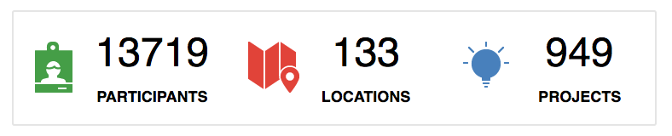
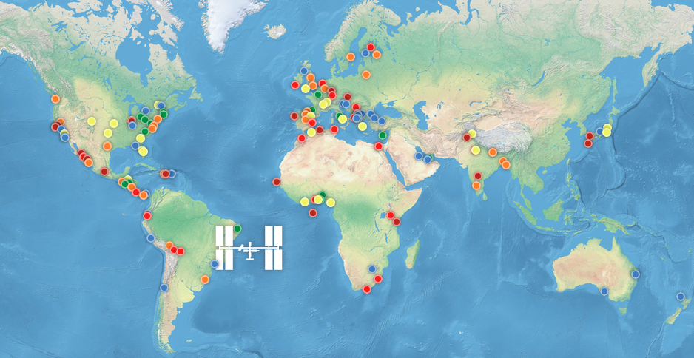
Results
Notes:
One Column Layout

Slide 7





Promotion
SOCIAL/COMMUNITY
Large community of participants and people interested in the challenges being solved helped promote and spread the word of Space Apps challenge
8,577 Likes
12K followers
2300 Tweets
100s of videos of participants projects
MASSIVE ONLINE MEDIA COVERAGE
They received tons of coverage on major media sites, blogs, sponsor sites, government sites, academic institutions etc
Alot of coverage in smaller niche news and blog sites
LOCAL COLLABORATOR PROMOTION
Local collaborators promoted their space apps hackathon location in their local language to to their community to recruit and promote for their specific HUB
Notes:
One Column Layout

Slide 8
In-Person Participation
Each physical HUB location was unique and the experience largely depending on the local collaborators that organized and managed the HUB.
Ex. Brisbane, Australia hackathon was sponsored by Microsoft and had keynote speakers, mentors, demonstrations, interactive workshops
Compared to a IBM Bluemix HUB which encouraged people to use Bluemix,
Compared to Cleveland, USA hackathon which was hosted in the Nasa state of the art Mission intergration center and had talks from top Nasa scientists
Some HUBs were just a location to meet other hackers and work.
Local HUBS were also allowed to offer their own prizes, recruit their own sponsors for that HUB and the judging structure was largely up to them.
Notes:
One Column Layout

Slide 9
Virtual Participation
REGISTRATION
Virtual Participation was open to anyone anywhere on Planet Earth
To register as a virtual participant user clicked a green button on the top of any page on the website and then registered online
BUILDING A VIRTUAL TEAM
Teams were formed based on the challenge they chose.
Start a new team
1) Create a Project.
2) add your info into the Matchmaking section on your chosen Challenge page.
3) Build your team - invite friends or check the Matchmaking section for people that want to work with you.
find a team to join
1) Add your information into the Matchmaking section
2) Search the Matchmaking section for teams that are looking for you.
REVIEW PROCESS
Nasa reviewed all the virtual projects submitted and then choose 2 projects to move onto the Global Level to compete with the rest of the best projects from the physical locations
RESULTS
120 virtual projects were submitted
Notes:
One Column Layout

Slide 10
Judging
LOCAL JUDGING
This judging occurred at the physical HUBS and was used to short list projects for the global competition.
Nasa allowed the local “collaborators” to set the judging categories and processes.
Each local event could nominate up to two projects to advance to global judging.
GLOBAL JUDGING
In the global judging round, a panel of NASA judges selected the winners in each of the five finalist categories: Best Mission Concept, Best Use of Hardware, Best Use of Data, Most Inspiring, and Galactic Impact based on the Judging Criteria on the next page.
Notes:
One Column Layout

Slide 11
Global Judging Criteria
Impact
How much impact (quality and quantity) can this project have? Does it solve a big problem or a little problem?
Creativity
How creative is the approach? Is the project new and something that hasn’t been attempted before? Is it something that isn't being addressed by the market?
Product
How well does this project fit the needs of the challenge it addresses? How user friendly is the technology? Is it a complete solution or does it have a long way to go?
Sustainability
How good is the plan for next steps? How prepared is the project team to continue their work beyond the event? Is the project organized in a way so others can take the project to the next level?
Presentation
How well did the team communicate their project? Are they effective in telling the story of the project and why it is important?
Notes:
One Column Layout

Slide 12

People's Choice Award
Each local event selected one People's Choice nomination to forward to the Space Apps team.
The Space Apps team then reviewed all the nominations and selected the best 15 projects.
The top 15 People’s Choice candidates were announced on the Space Apps website and give their own page.
The public could vote for their favorite projects via social media and the teams were encouraged to promote their projects.
NASA’s Space Apps team collected social media analytics and the winning team was determined based on a formula that took into account the number of tweets, unique users and timeline deliveries.
total of 156,007 votes cast for the 15 projects
Notes:
One Column Layout

Slide 13
Prizes
The local hosts were allowed to offer their own smaller prizes based on what the “collaborators” could provide and on the sponsors for that local HUB
Global winners won entry to a NASA launch event. Winners and one guest are required to pay their own expenses and NASA will supply transportation to and from the launch site.
The main form of motivation seemed to be solving a difficult challenge that no one has been able to yet and by doing so making the world a better place.

Slide 14
Global Winners
Best Use of Data - NYSPACETAG
There's no unified classification of NASA data. They solved this by extracting natural keyphrases from more than 26,000 datasets and building a visual search tool for keywords. Since the hackathon, the project has already been picked up for an internal NASA big data workshop.
Best Use of Hardware- VALKYRIE
Gesture and voice recognition using a "smart" glove and mobile device(Android, iOS or smartwatch). You can use it for home automation as well as controlling devices such as robo arm, robots etc. Valkyrie is connected to the IOT using WiFi, BLE, Bluetooth etc.
Best Mission Concept- ARACHNOBEEA
This project incorporates two concepts - a flying platform and a walker robot and creates a solution to easily give targeted cargo's coordinates and the destination to where it should be moved.
Notes:
One Column Layout

Slide 15
Global Winners
GALACTIC IMPACT- CROPP
CROPP (Cultures Risks Observation and Prevention Platform) is an easy and user-friendly application designed to help farmers in monitoring their lands. The service will provide data gathered at two different levels. Measurements will be merged with satellite observations to give users practical information about possible risks that could threaten their crops.
MOST INSPIRATIONAL - TRACKING/SENSING ANDROID ROBOT
Team Created a mobile robot platform that is capable of extracting data from nearby objects using on-board sensors present in an Android Smartphone. The team wanted to harness the power of these tiny but powerful devices and integrate them with image processing software, in order to get a better understanding of everyday objects around us
PEOPLE'S CHOICE AWARD - NATURAL-EVENTS-EXPLORER
The NatEv Explorer project helps discover the natural hazards and catastrophes that happen every second around the world. It encourages crowdsourcing to discover and “tag” interesting natural events and potential threats to humans through the real-time earth observatory data provided by NASA.
Notes:
One Column Layout

Slide 16
What they did right
There themes and the challenges within those themes really helped participants nail down what they wanted to work on for the hackathon. Teams knew exactly what their projects were about.
The challenges were all very interesting and enticing, making people want to participate in the hackathon in order to solve them. They inspired people to participate with no real cash prizes up for grab.
They were able to recruit such a large number of HUB locations around the world because they empower local “collaborators” to handle much of the responsibility
They had virtual participation available globally and teams building for each challenge.
People’s Choice award got the community really involved

